Slide 1
What is the Internet doing to me?
(Security and privacy for people in a
connected world)
Some legal issues
Online class
DSARs, RtbF Requests, etc
Dr Eoin O’Dell @cearta

Slide 2

General Data Protection Regulation
(Regulation (EU) 2016/679) (GDPR)
99 Articles
173 Recitals
21 footnotes
88 pages
; image:
https://pixabay.com/en/gdpr-regulation-protection-data-3438443/

Slide 3

Data Protection Act 2018
; image:
http://www.irishstatutebook.ie/static/images/homepage/2.png

Slide 4

Personal data
; image:
https://pixabay.com/en/business-internet-web-technology-1012761/

Slide 5

Controllers and Processors
; image:
https://www.youtube.com/watch?v=wIjgZhAjQS4 (element; still 20:36)

Slide 6
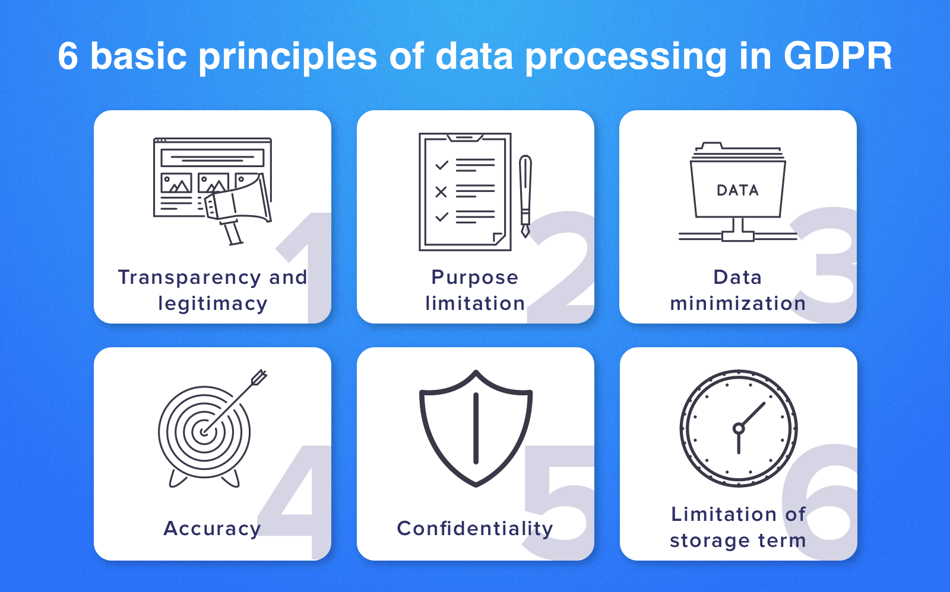
Art 5(1) GDPR - Principles
; image:
https://www.cleveroad.com/images/article-previews/basic-principles-1.png
https://about.fb.com/news/2019/09/privacy-matters-dating/
https://www.dataprotection.ie/en/news-media/press-releases/dpc-statement-facebook-dating-feature

Slide 7
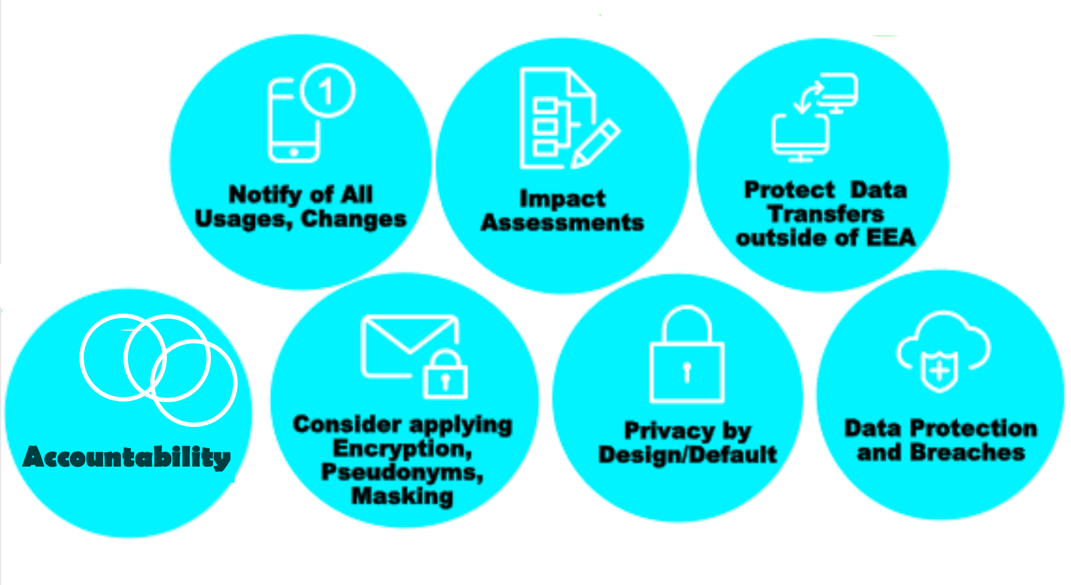


Obligations of Controllers
; image:
https://financialservicesblog.accenture.com/six-practical-steps-for-hr-managers-to-become-gdpr-ready (element) (modified)

Slide 8
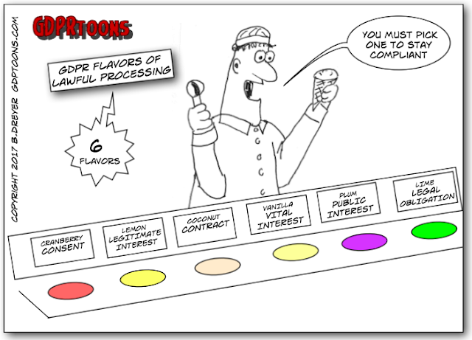
Article 6 GDPR – lawfulness of processing
; images:
http://www.gdprtoons.com/2017/08/the-gdpr-provides-six-6-grounds-for_29.html
& https://pixabay.com/en/icecream-cone-scoop-chocolate-ice-32104/

Slide 9
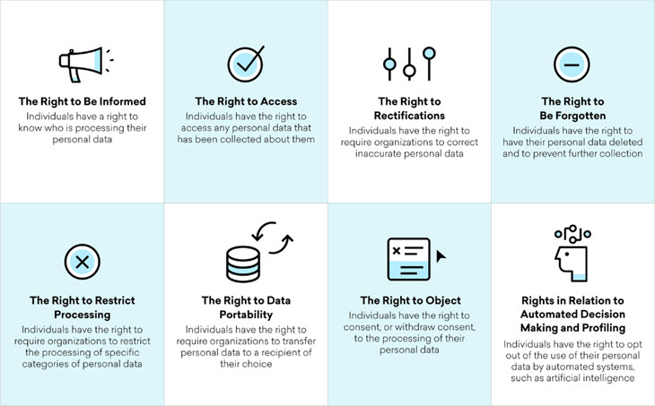
GDPR Data Subject Rights
passim Art 15 (&19) Art 16 (&19) Art 17 (&19)
Art 18 Art 20 Art 21 Art 22
; image:
http://www.nuigalway.ie/media/informationsolutionsservices/images/servicesforstaffsection/security/Rights.jpg

Slide 10


GDPR Data Subject Rights
Art 15 (&19) Art 16 (&19) Art 17 (&19)
; image:
http://www.nuigalway.ie/media/informationsolutionsservices/images/servicesforstaffsection/security/Rights.jpg

Slide 11

GDPR Data Subject Rights
; image:
https://pix4free.org/photo/21715/assessment.html

Slide 12
Assessment
Please do a GDPR data subject access request or a right to be forgotten/erasure request.
Choose your target service via the link on Blackboard. We would very much like some diversity in terms of service providers, so please don’t all choose the obvious one(s).
This assessment is worth 25% of your final mark.
Submit via Blackboard on or before 30
November 2021 (anytime on Earth).

Slide 13







Restrictions, exceptions, derogations
Articles 2&3 Scope | Article 23 Restrictions | Article 86 FoI
Article 88 Employment | Article 89 Research | Article 91 Church
; images:
vectors via pixabay below
Notes:
https://pixabay.com/vectors/home-house-icons-jims-card-1294564/
https://pixabay.com/vectors/road-sign-roadsign-no-prohibited-147409/
https://pixabay.com/vectors/folder-file-cabinet-office-file-146153/
https://pixabay.com/illustrations/security-industrial-logistic-1491514/
https://pixabay.com/vectors/beakers-experiment-flasks-research-309864/
https://pixabay.com/vectors/house-icon-silhouette-cross-304072/

Slide 14
Restrictions, exceptions, derogations
 | Article 89 Research
; image:
vector via pixabay
Notes:
https://pixabay.com/vectors/beakers-experiment-flasks-research-309864/

Slide 15
Restrictions, exceptions, derogations
Where personal data are processed, and further processed, for research purposes, Member State law may provide for derogations from the rights of:
access
rectification
restriction
object
 | Article 89 Research
section 61
DPA, 2018
; image:
vector via pixabay
Notes:
https://pixabay.com/vectors/beakers-experiment-flasks-research-309864/

Slide 16
What is the GDPR/DPA definition of “research”?
; images:

Slide 17

What is the GDPR/DPA definition of “research”?
; images:
http://www.freestockphotos.biz/stockphoto/11446

Slide 18
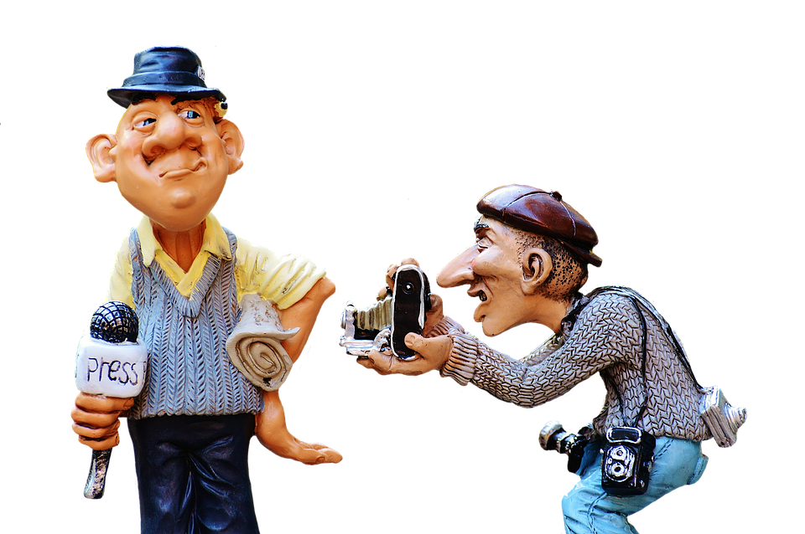
Article 85 GDPR
; image:
https://pixabay.com/photos/press-journalist-photographer-news-2643073/

Slide 19
Article 85(1) GDPR
Member States shall by law reconcile the right to the protection of personal data pursuant to this Regulation with the right to freedom of expression and information, including processing for
journalistic purposes and
the purposes of academic,
artistic or literary expression.
; image:
https://pixabay.com/photos/press-journalist-photographer-news-2643073/

Slide 20

Section 43(1) DPA18
(1) The processing of personal data for the purpose of exercising the right to freedom of expression and information, including processing for journalistic purposes or for the purposes of academic,
artistic or literary expression,
shall be exempt from
compliance with … [GDPR]
; image:
https://pixabay.com/photos/press-journalist-photographer-news-2643073/

Slide 21
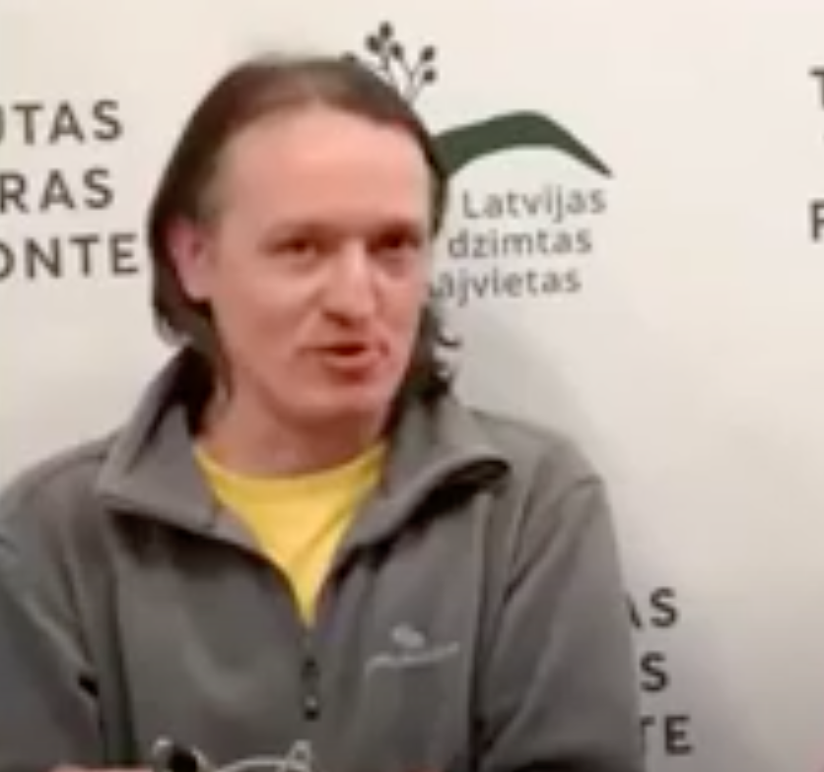
Case 345/17 Buivids
; image:
https://www.youtube.com/watch?v=4mrbulU9PJw (element; still 46:24 )

Slide 22
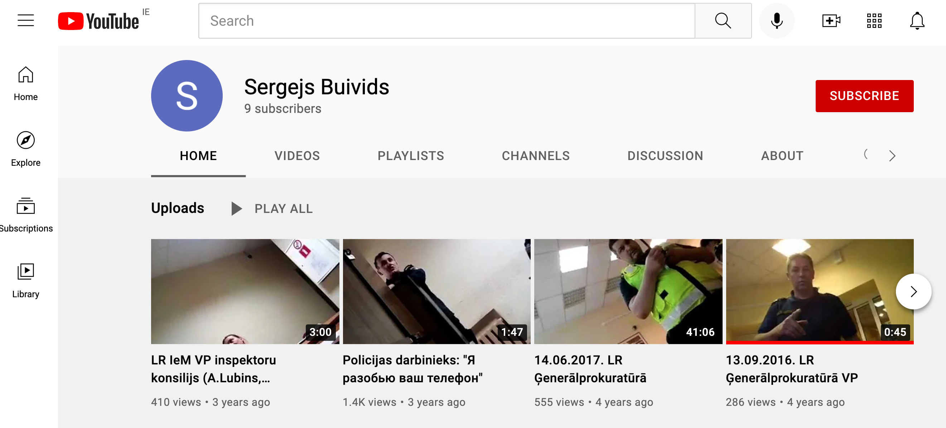
Case 345/17 Buivids
; image:
https://www.youtube.com/channel/UCRxqD0pUUnXs9j_vDvfCmRQ

Slide 23
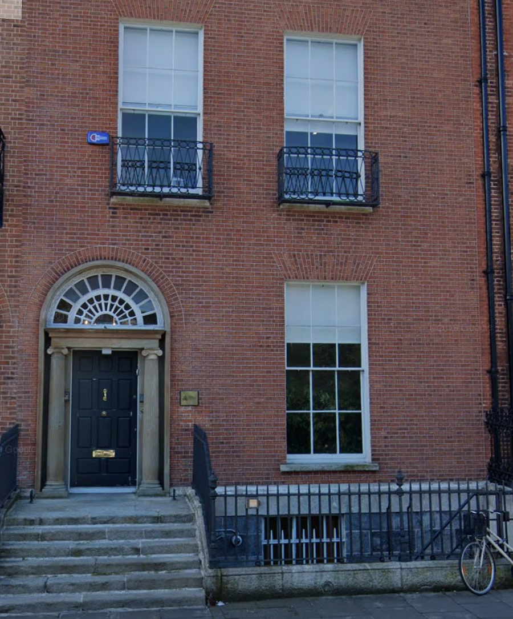

DPC enforcement of the GDPR / DPA 18
Year Budget Staff
2022 €26m [220+*]
2021 €19.1m [200+*]
2020 €16.9m 200
2019 €15.2m 180
2018 €11.7m 140
2017 €7.5m 105
2016 €4.7m 70
2015 €3.6m 48
2014 €1.9m 31
Budget as allocated in the national Budget the October prior to the relevant year. Staff as at end of relevant year. [*=projected].
; image:
Via Google Streetview; stats: https://www.lawsociety.ie/gazette/top-stories/dpc-budget-rises-tenfold-in-seven-years/ and DPC annual reports

Slide 24


Article 83 GDPR - Administrative Fines
; image:
https://www.flickr.com/photos/stevensnodgrass/11078286805

Slide 25

Article 83 GDPR - Administrative Fines
; image:
https://www.amazon.co.uk/Amazon-Logo-Squid-Amazon-co-uk-Voucher/dp/B07S6C1DZ6

Slide 26
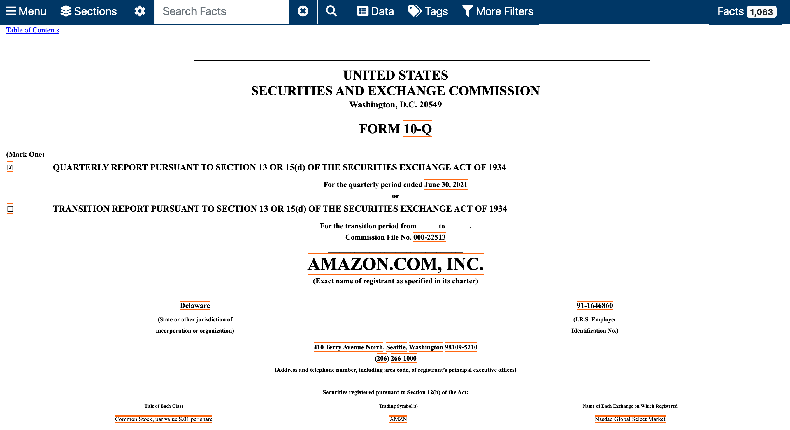
Article 83 GDPR - Administrative Fines
; image:
https://www.sec.gov/ix?doc=/Archives/edgar/data/0001018724/000101872421000020/amzn-20210630.htm

Slide 27
Article 83 GDPR - Administrative Fines
; image:
https://www.sec.gov/ix?doc=/Archives/edgar/data/0001018724/000101872421000020/amzn-20210630.htm

Slide 28
Article 83 GDPR - Administrative Fines
On July 16, 2021, the Luxembourg National Commission for Data Protection (the “CNPD”) issued a decision against Amazon Europe Core S.à r.l. claiming that Amazon’s processing of personal data did not comply with the EU General Data Protection Regulation. The decision imposes a fine of €746 million and corresponding practice revisions. We believe the CNPD’s decision to be without merit and intend to defend ourselves vigorously in this matter.
; image:
https://www.sec.gov/ix?doc=/Archives/edgar/data/0001018724/000101872421000020/amzn-20210630.htm

Slide 29

Article 83 GDPR - Administrative Fines
; image:
https://cnpd.public.lu/en/actualites/international/2021/08/decision-amazon-2.html

Slide 30

Article 83 GDPR - Administrative Fines
; image:
https://www.laquadrature.net/en/2021/07/30/amazon-fined-746-million-euros-following-our-collective-legal-action/

Slide 31
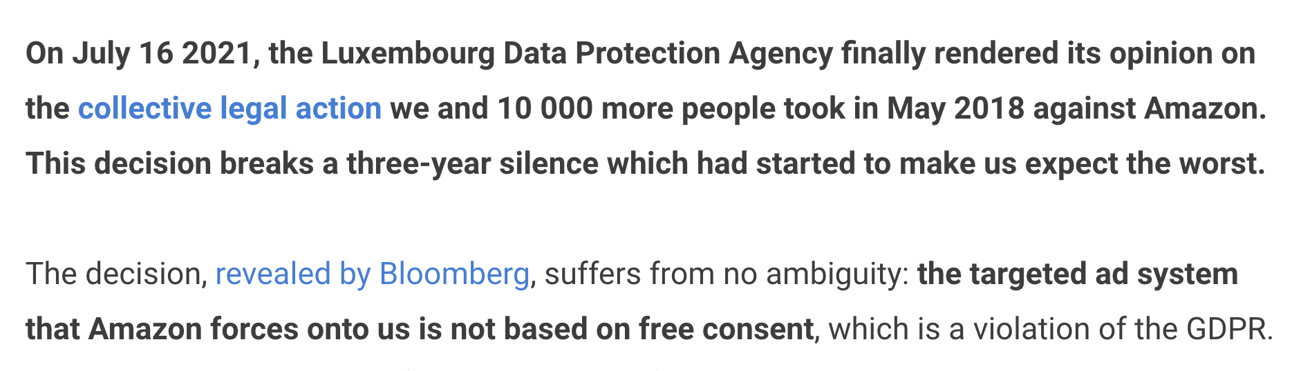
Article 83 GDPR - Administrative Fines
; image:
https://www.laquadrature.net/en/2021/07/30/amazon-fined-746-million-euros-following-our-collective-legal-action/

Slide 32


DPC WhatsApp Decision (20 August 2021)
DPC found that WhatsApp had not discharged its GDPR transparency obligations with regard to the provision of information and the transparency of that information to both users and non-users of WhatsApp’s service. This includes information provided to data subjects about the processing of information between WhatsApp and other Facebook companies.
FINE: €225 million
; image:
https://www.dataprotection.ie/ & https://www.whatsapp.com/ & https://about.meta.com/

Slide 33

Article 82 GDPR – Compensation
; image:
https://pix4free.org/photo/5079/damages.html

Slide 34
Obligations of Controllers
; image:
https://financialservicesblog.accenture.com/six-practical-steps-for-hr-managers-to-become-gdpr-ready (element) (modified)

Slide 35
Obligations of Controllers
; image:
https://financialservicesblog.accenture.com/six-practical-steps-for-hr-managers-to-become-gdpr-ready (element) (modified)

Slide 36
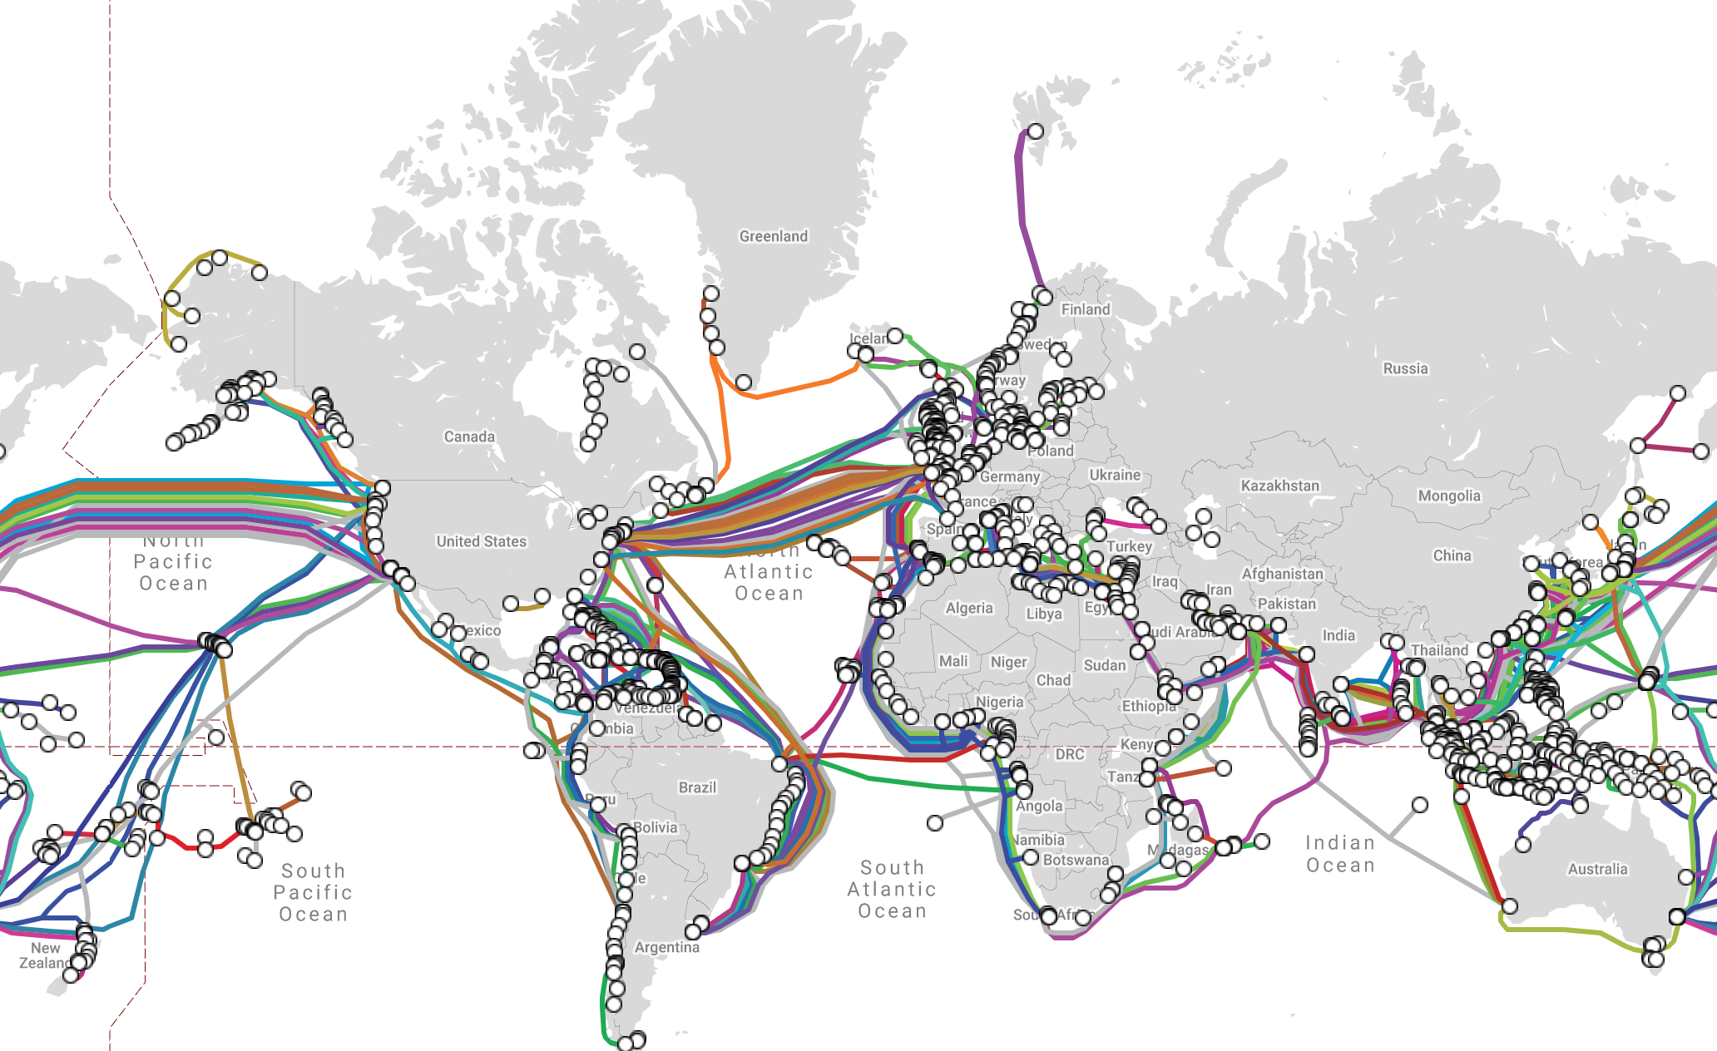
Cross-Border Transfers of Data
; image:
https://www.submarinecablemap.com/#/

Slide 37


Cross-Border Transfers of Data
; image:
https://www.submarinecablemap.com/#/
https://pixabay.com/vectors/satellite-orbit-communication-gps-307326/

Slide 38
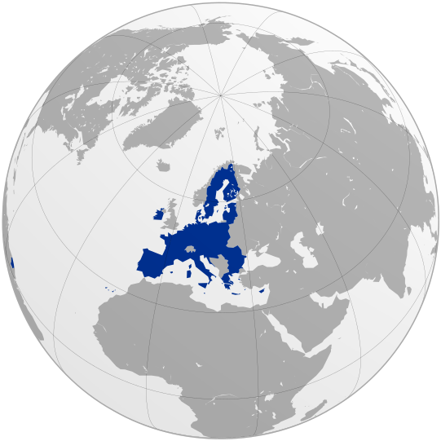
Chapter 5 GDPR
Transfers of personal data to third countries
Article 45
Transfers on the basis of an adequacy decision
Article 46
Transfers subject to appropriate safeguards
(including standard contractual clauses)
; image https://commons.wikimedia.org/wiki/File:EU_on_a_globe.svg

Slide 39
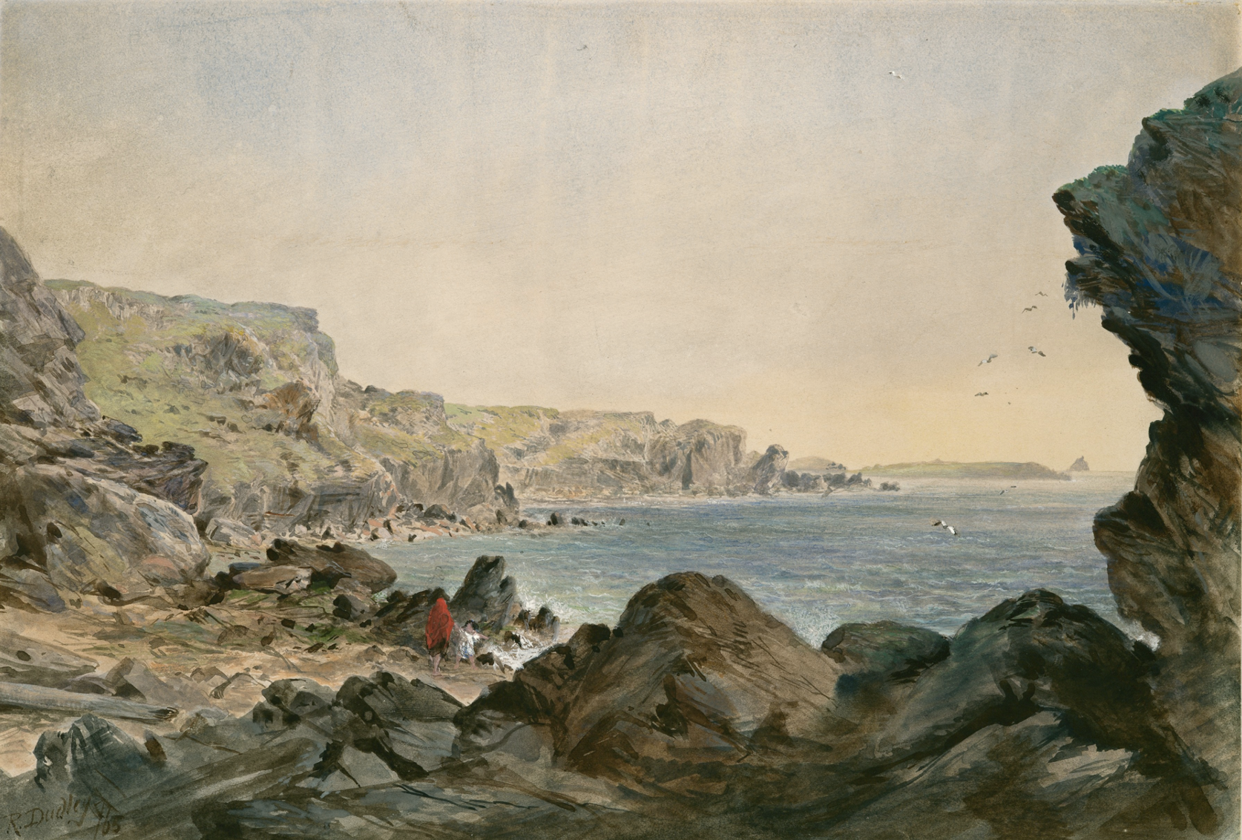
Safe Harbo(u)r
https://commons.wikimedia.org/wiki/File:Foilhummerum_Bay,_Valentia,_Looking_Seawards_from_the_Point_at_Which_the_Cable_Reaches_the_Shore_of_Ireland_MET_DP119839.jpg

Slide 40
Cross-Border Transfers of Data
; image:
https://www.submarinecablemap.com/#/
https://pixabay.com/vectors/satellite-orbit-communication-gps-307326/

Slide 41
Cross-Border Transfers of Data
; image:
https://www.submarinecablemap.com/#/
https://pixabay.com/vectors/satellite-orbit-communication-gps-307326/

Slide 42
Safe Harbo(u)r
https://commons.wikimedia.org/wiki/File:Foilhummerum_Bay,_Valentia,_Looking_Seawards_from_the_Point_at_Which_the_Cable_Reaches_the_Shore_of_Ireland_MET_DP119839.jpg
https://privacysos.org/blog/huge-win-for-privacy-europe-highest-court-strikes-down-e-u-u-s-data-transfer-pact/

Slide 43

Safe Harbo(u)r
https://commons.wikimedia.org/wiki/File:Foilhummerum_Bay,_Valentia,_Looking_Seawards_from_the_Point_at_Which_the_Cable_Reaches_the_Shore_of_Ireland_MET_DP119839.jpg
https://privacysos.org/blog/huge-win-for-privacy-europe-highest-court-strikes-down-e-u-u-s-data-transfer-pact/

Slide 44
Privacy Shield
; image:
https://www.submarinecablemap.com/#/
https://pixabay.com/vectors/satellite-orbit-communication-gps-307326/
https://pixabay.com/vectors/shield-escutcheon-heraldic-shield-31869/

Slide 45

Privacy Shield
; image:
https://www.submarinecablemap.com/#/
https://pixabay.com/vectors/satellite-orbit-communication-gps-307326/
https://pixabay.com/vectors/shield-escutcheon-heraldic-shield-31869/

Slide 46
Privacy Shield
; image:
https://www.submarinecablemap.com/#/
https://pixabay.com/vectors/satellite-orbit-communication-gps-307326/
https://pixabay.com/vectors/shield-escutcheon-heraldic-shield-31869/

Slide 47



After Privacy Shield?
; image: https://www.whitehouse.gov/briefing-room/statements-releases/2022/10/07/fact-sheet-president-biden-signs-executive-order-to-implement-the-european-union-u-s-data-privacy-framework/ & https://www.whitehouse.gov/briefing-room/statements-releases/2022/10/07/fact-sheet-president-biden-signs-executive-order-to-implement-the-european-union-u-s-data-privacy-framework/ & https://www.flickr.com/photos/bidenforpresident/50227217118/in/photostream/

Slide 48

After Privacy Shield?
https://en.wikipedia.org/wiki/Schw%C3%A4bisch_Gm%C3%BCnd

Slide 49
GDPR Data Subject Rights
; image:
https://pix4free.org/photo/21715/assessment.html

Slide 50
GDPR Data Subject Rights
Art 15 (&19) Art 16 (&19) Art 17 (&19)
; image:
http://www.nuigalway.ie/media/informationsolutionsservices/images/servicesforstaffsection/security/Rights.jpg

Slide 51

Data Subject Access Request
; image:
Originally via via http://europe-v-facebook.org/EN/Media/media.html also via https://arstechnica.com/tech-policy/2012/11/how-one-law-student-is-making-facebook-get-serious-about-privacy/ (element)

Slide 52
Data Subject Access Request
https://commons.wikimedia.org/wiki/File:Foilhummerum_Bay,_Valentia,_Looking_Seawards_from_the_Point_at_Which_the_Cable_Reaches_the_Shore_of_Ireland_MET_DP119839.jpg
https://privacysos.org/blog/huge-win-for-privacy-europe-highest-court-strikes-down-e-u-u-s-data-transfer-pact/

Slide 53
How does (eg) Facebook get data about you?
You give it data when you

Slide 54
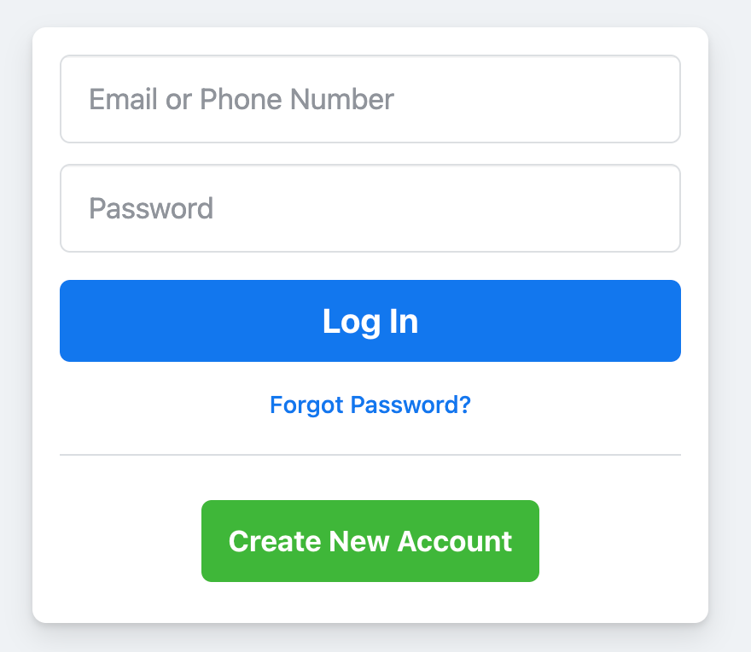
How does (eg) Facebook get data about you?
You give it data when you
(i) register;
; image via Facebook.com

Slide 55

How does (eg) Facebook get data about you?
You give it data when you
(i) register;
(ii) use FB itself (likes, interactions, tags, etc);
; image: https://commons.wikimedia.org/wiki/File:Facebook_logo_thumbs_up_like_transparent_SVG.svg

Slide 56
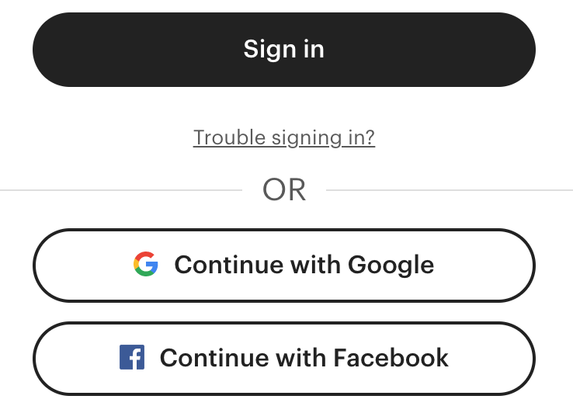
How does (eg) Facebook get data about you?
You give it data when you
(i) register;
(ii) use FB itself (likes, interactions, tags, etc);
(iii) use FB on other sites (login/like/share etc).
; image via etsy.com

Slide 57

How does (eg) Facebook get data about you?
You give it data when you
(i) register;
(ii) use FB itself (likes, interactions, tags, etc);
(iii) use FB on other sites (login/like/share etc).
Your friends give it data about you.
; image: https://www.facebook.com/help/227499947267037

Slide 58
How does (eg) Facebook get data about you?
You give it data when you
(i) register;
(ii) use FB itself (likes, interactions, tags, etc);
(iii) use FB on other sites (login/like/share etc).
Your friends give it data about you.
Facebook (i) buys data from brokers; and

Slide 59
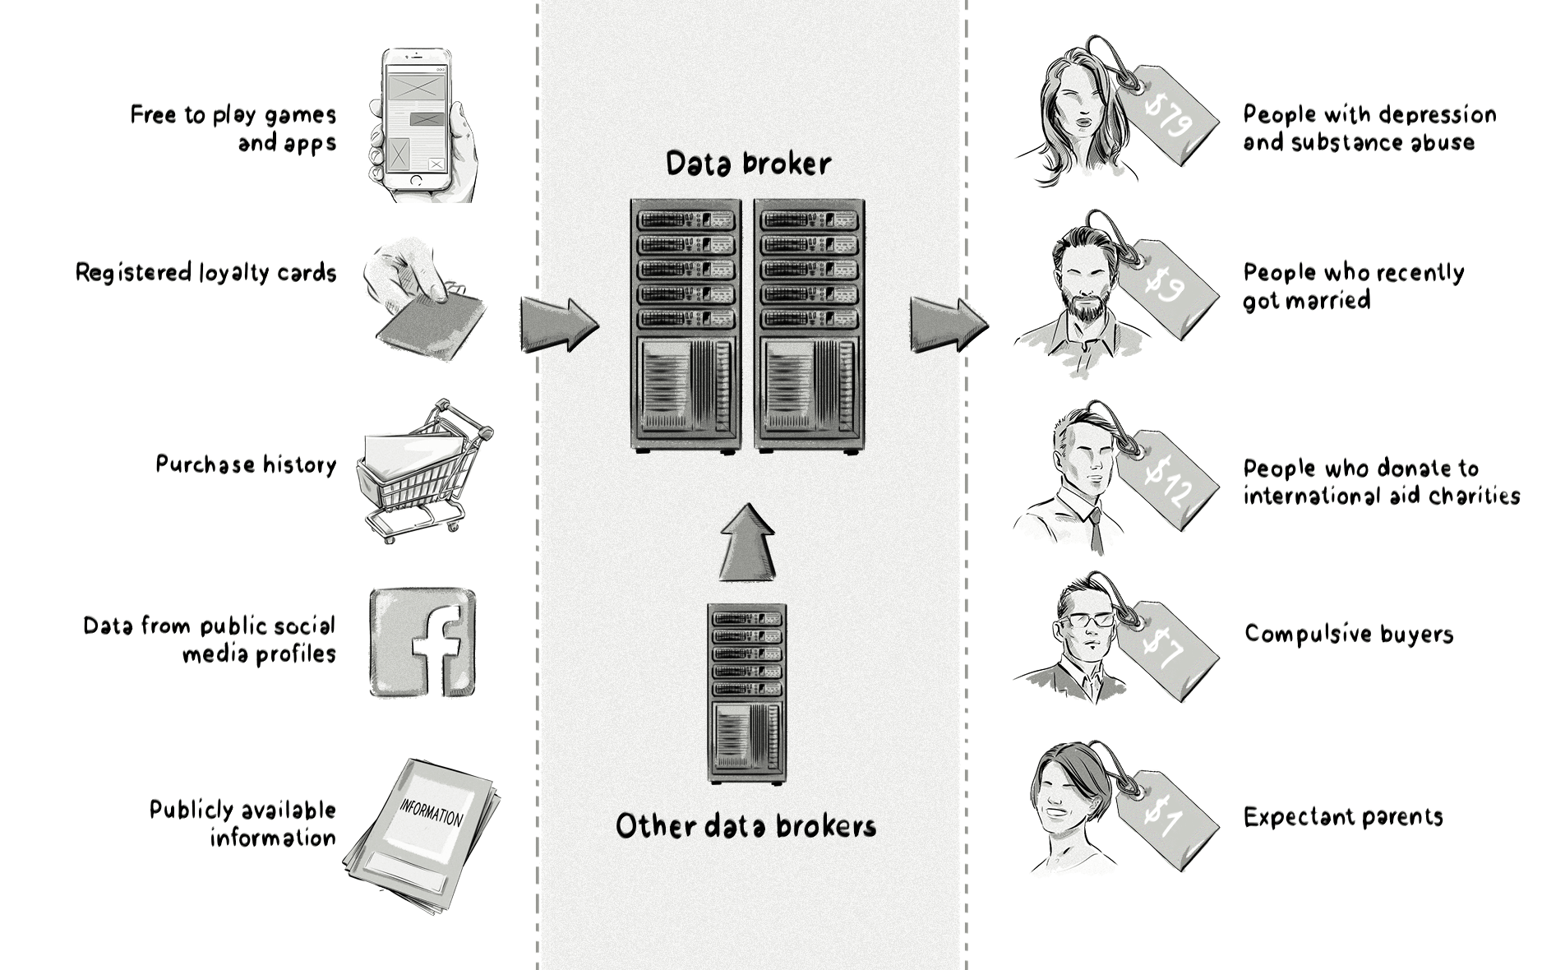
How does (eg) Facebook get data about you?
; image: https://clearcode.cc/blog/what-is-data-broker/

Slide 60
How does (eg) Facebook get data about you?
You give it data when you
(i) register;
(ii) use FB itself (likes, interactions, tags, etc);
(iii) use FB on other sites (login/like/share etc).
Your friends give it data about you.
Facebook (i) buys data from brokers; and
(ii) mines all of the above.

Slide 61
How does (eg) Facebook get data about you?
You give it data when you
(i) register;
(ii) use FB itself (likes, interactions, tags, etc);
(iii) use FB on other sites (login/like/share etc).
Your friends give it data about you.
Facebook (i) buys data from brokers; and
(ii) mines all of the above.

Slide 62

How does (eg) Facebook get data about you?
; https://theconversation.com/shadow-profiles-facebook-knows-about-you-even-if-youre-not-on-facebook-94804

Slide 63
Article 15 GDPR
Right of access by the data subject
(1) The data subject shall have the right to obtain from the controller
; text: https://eur-lex.europa.eu/eli/reg/2016/679/oj &
https://iapp.org/resources/article/the-eu-general-data-protection-regulation/#A15

Slide 64
Article 15 GDPR
Right of access by the data subject
(1) The data subject shall have the right to obtain from the controller
confirmation as to whether or not personal data concerning him or her are being processed,

Slide 65
Article 15 GDPR
Right of access by the data subject
(1) The data subject shall have the right to obtain from the controller
confirmation as to whether or not personal data concerning him or her are being processed, and,
where that is the case, access to the
[data subject’s] personal data

Slide 66
Article 15 GDPR
Right of access by the data subject
(1) The data subject shall have the right to obtain from the controller
confirmation as to whether or not personal data concerning him or her are being processed, and,
where that is the case, access to the
[data subject’s] personal data[,]
and the following information:

Slide 67
Article 15 GDPR
Right of access by the data subject
(a) purposes of processing;
(b) categories of personal data;
(c) recipients of the data;
(d) period of storage; …
(g) information as to the source of the data;
(h) the existence of automated
decision-making, including
profiling

Slide 68
Article 15 GDPR
Right of access by the data subject
(1) The data subject shall have the right to obtain from the controller … the following information:
(e) the existence of the right to request from the controller rectification or erasure of personal data or restriction of
processing … or to object;
(f) the right to lodge a complaint.

Slide 69
Article 15 GDPR
Right of access by the data subject
(3) The controller shall provide a copy of the personal data undergoing processing.

Slide 70
Article 15 GDPR
Right of access by the data subject
(3) The controller shall provide a copy of the personal data undergoing processing. ... Where the data subject makes the request by electronic means, and unless otherwise requested by the data subject, the information shall be provided in a commonly used electronic form.

Slide 71
Section 91 Data Protection Act 2018
Right of access
(1) [sets out Article 15 GDPR]
(2) Respond ASAP, within one month;
; text: http://www.irishstatutebook.ie/eli/2018/act/7/section/91/enacted/en/html#sec91

Slide 72
Section 91 Data Protection Act 2018
Right of access
(1) [sets out Article 15 GDPR]
(2) Respond ASAP, within one month;
(5)&(6) In complex cases, may add up to
two more months.

Slide 73
Section 91 Data Protection Act 2018
Right of access
(3) … the individual making the request shall provide the controller with such information as the controller may reasonably require to satisfy itself of the identity of the individual and to locate any relevant personal data or
information.

Slide 74

Who is this?
; image: https://www.flickr.com/photos/onionskn/7986185415/

Slide 75
How to make a data subject access request
Adam Ant
Stand and Deliver
; image: https://www.flickr.com/photos/onionskn/7986185415/

Slide 76
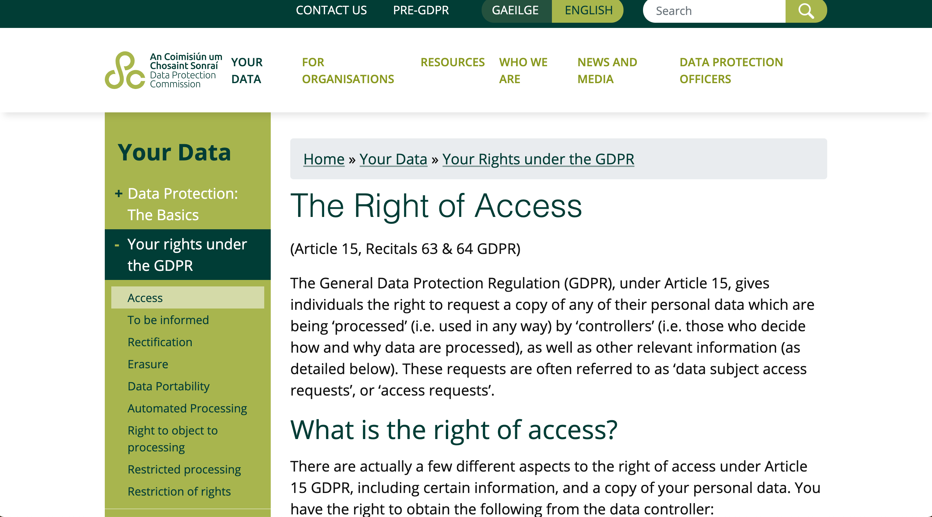

How to make a data subject access request
; image: https://www.dataprotection.ie/en/individuals/know-your-rights/right-access-information

Slide 77
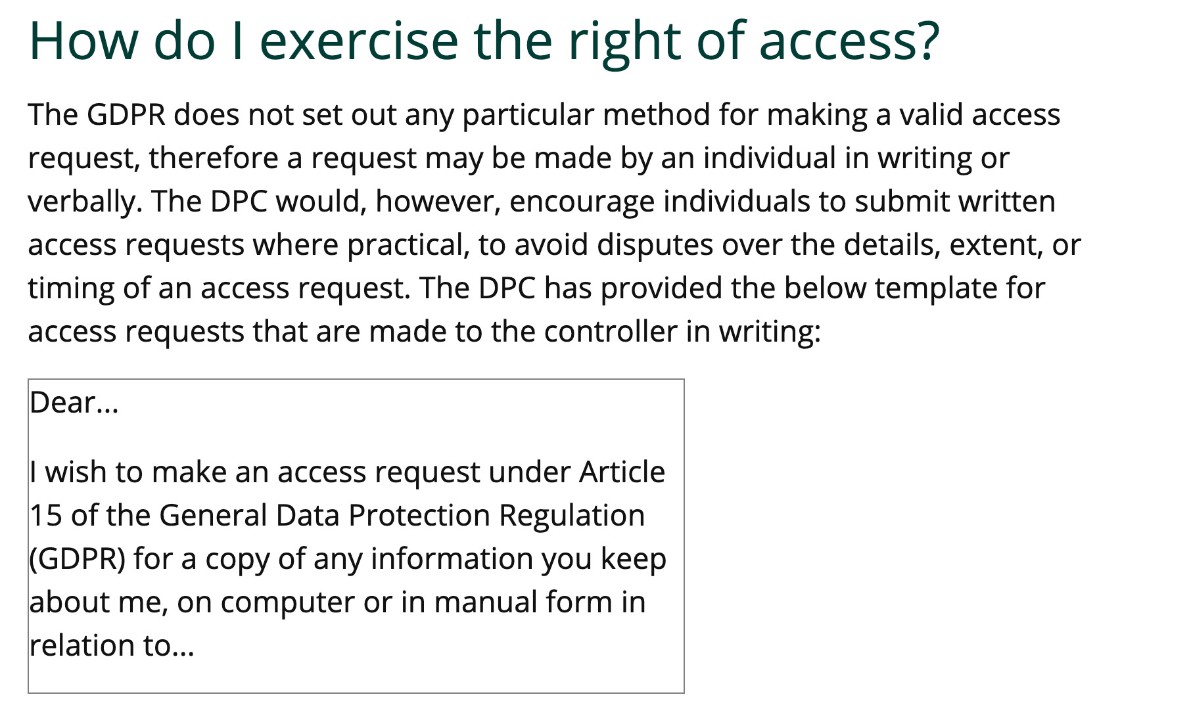
How to make a data subject access request
; image: https://www.dataprotection.ie/en/individuals/know-your-rights/right-access-information

Slide 78

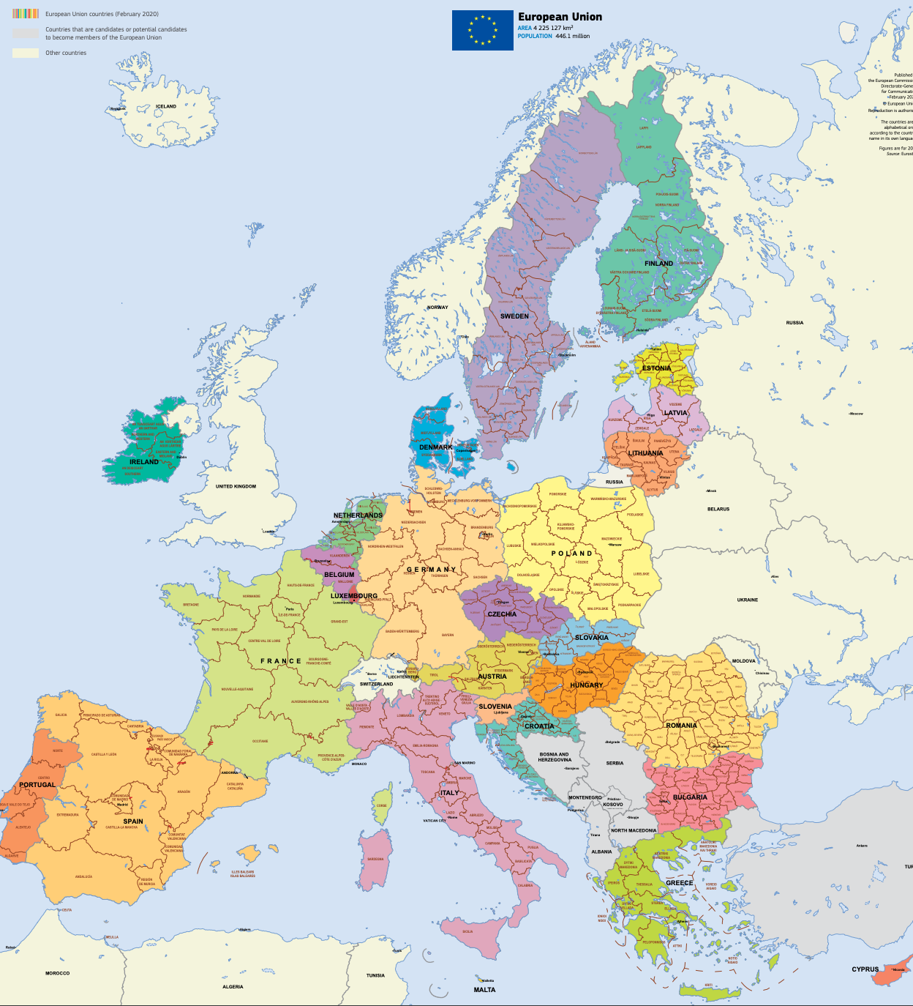

Other DPAs
; image: https://edpb.europa.eu/about-edpb/board/members_en &
via https://op.europa.eu/en/web/general-publications/maps

Slide 79
GDPR Data Subject Rights
Art 15 (&19) Art 16 (&19) Art 17 (&19)
; image:
http://www.nuigalway.ie/media/informationsolutionsservices/images/servicesforstaffsection/security/Rights.jpg

Slide 80
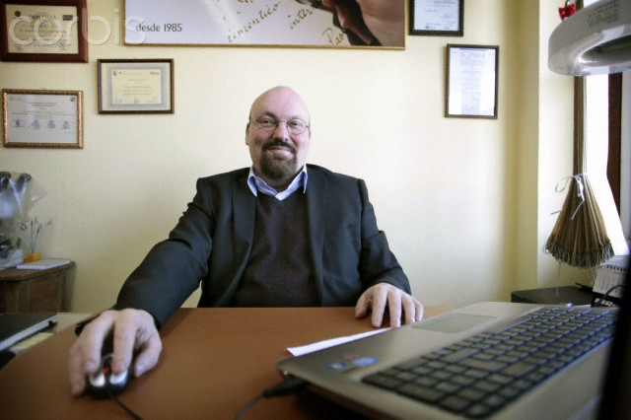
Who is this?
; image used by kind permission of the photographer, Jose Cabalar

Slide 81
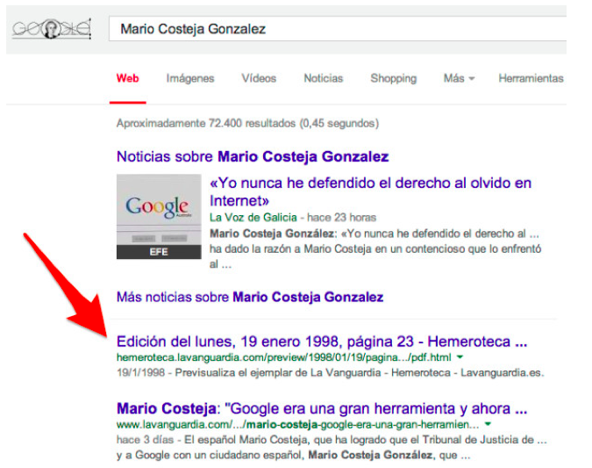

The search that started it all
; image http://searchengineland.com/figz/wp-content/seloads/2014/05/Mario_Costeja_Gonzalez_-_Buscar_con_Google-600x900.jpg

Slide 82
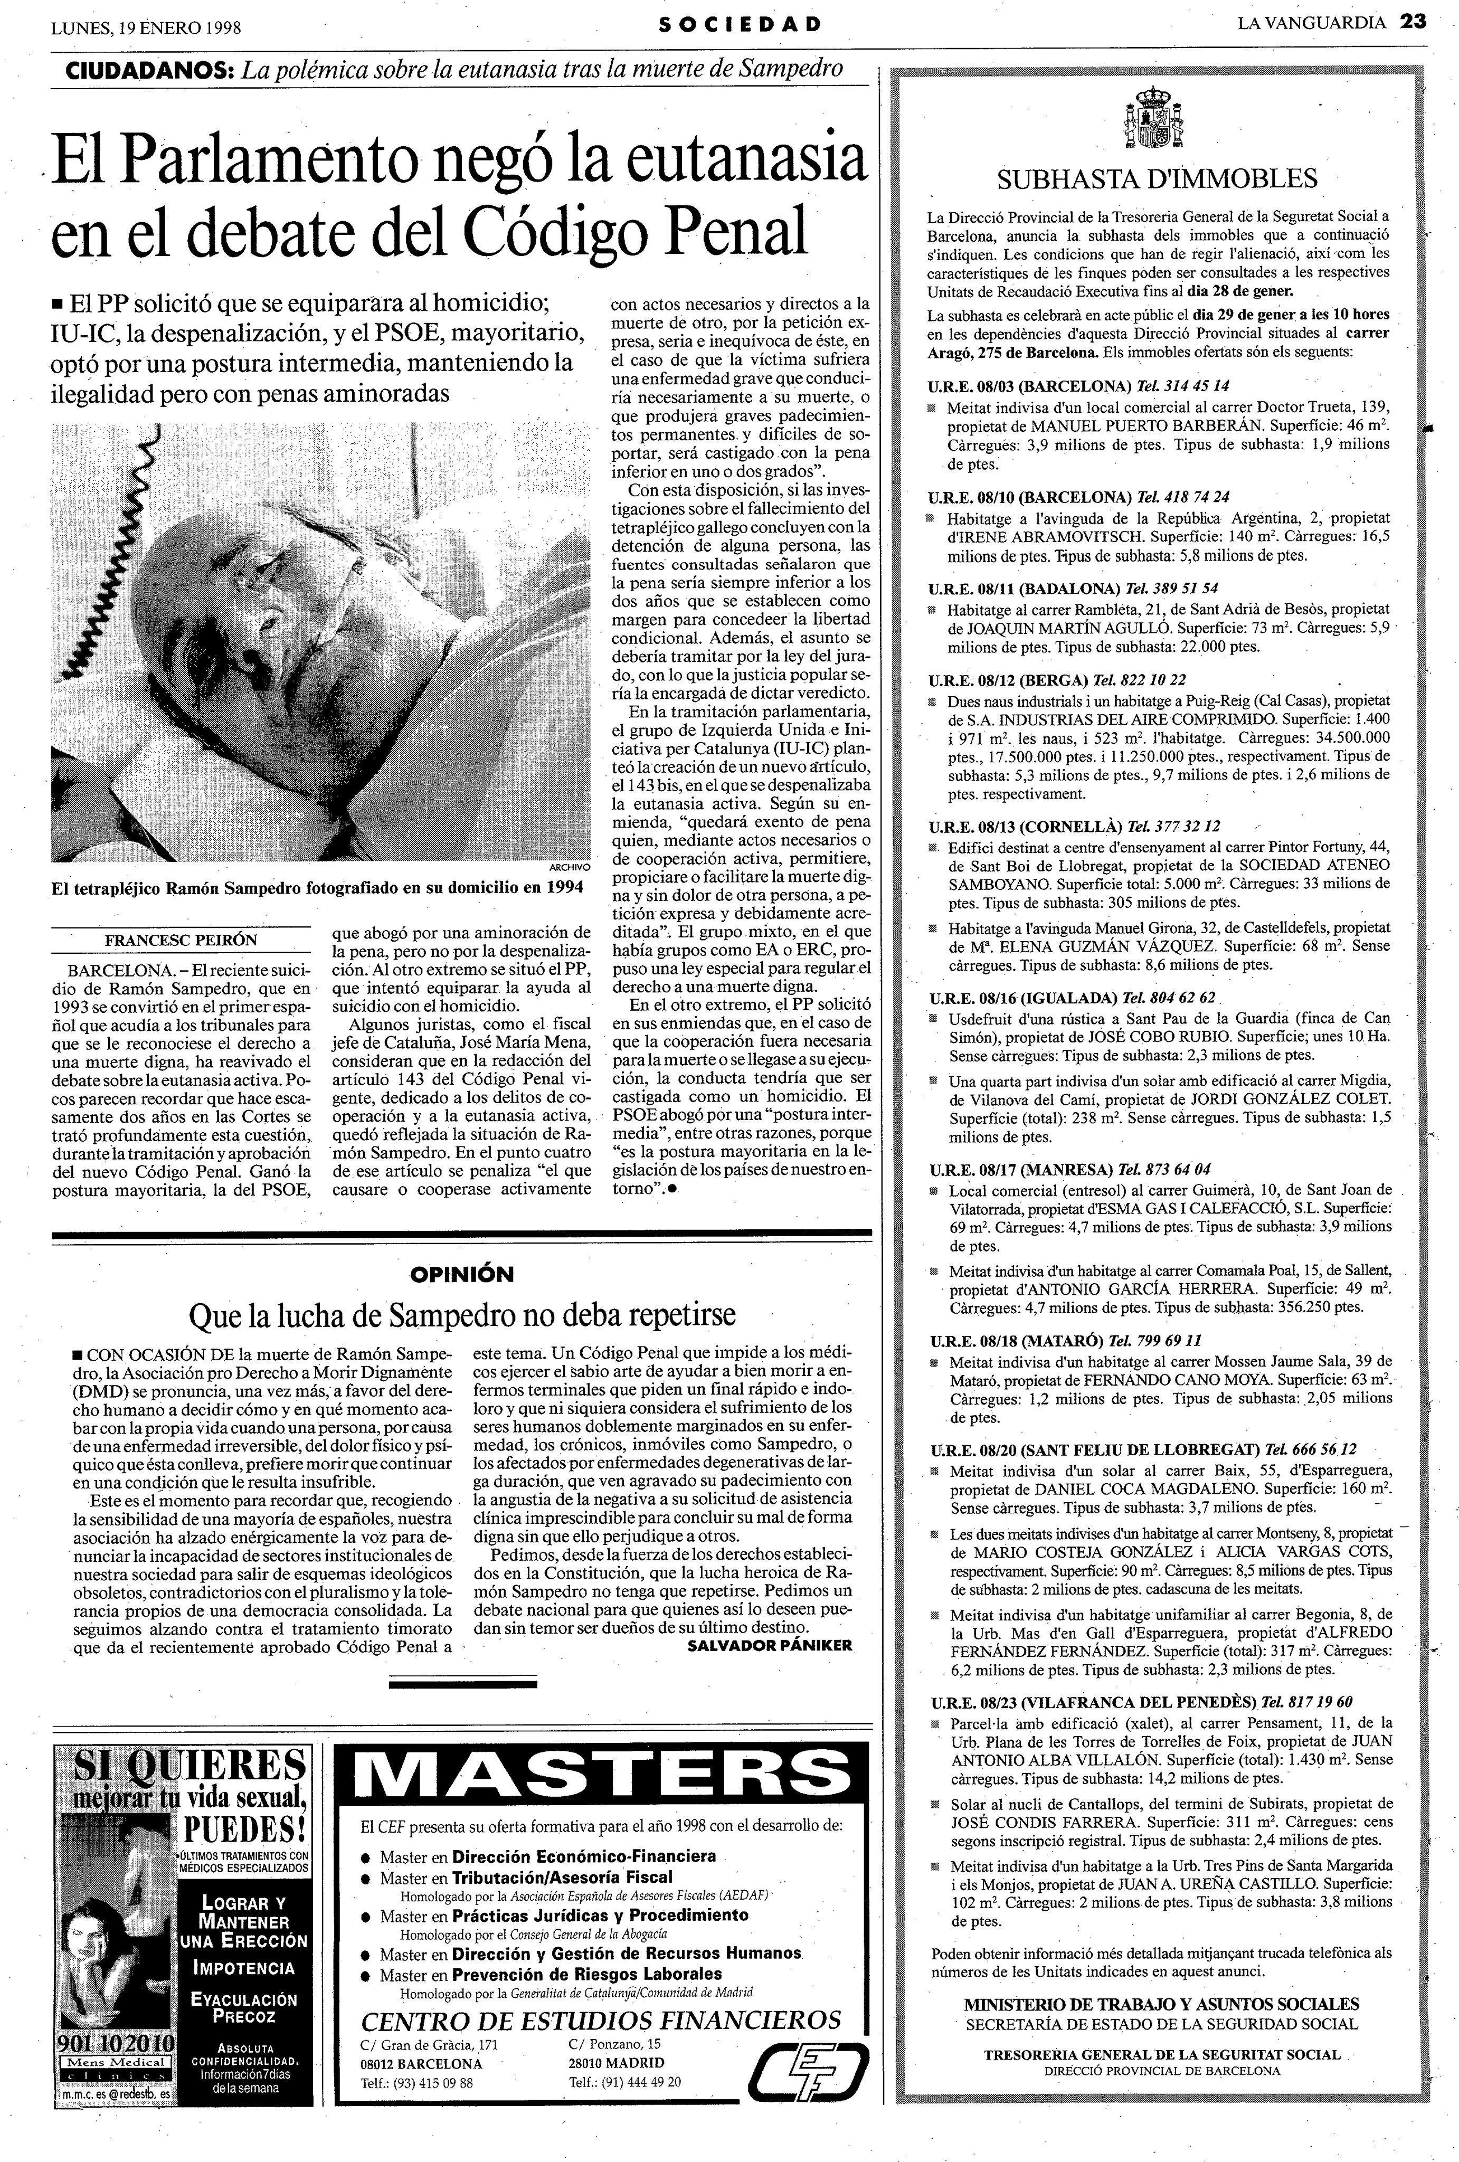
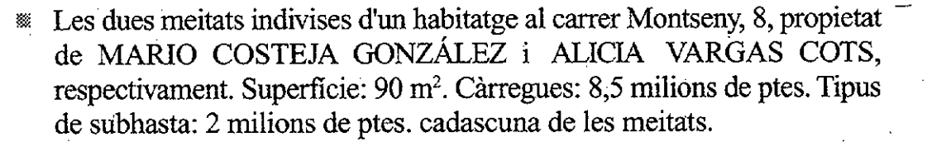
The search that started it all
The two halves of an undivided dwelling, 8 Montseny Street, property of MARIO COSTEJA GONZÁLEZ and ALICIA VARGAS COTS, respectively. Area: 90 m². Debt: 50,000 euro. Type of auction: 12,000 euro for each of the halves.
; image: http://hemeroteca.lavanguardia.com/preview/1998/01/19/pagina-23/33842001/pdf.html

Slide 83
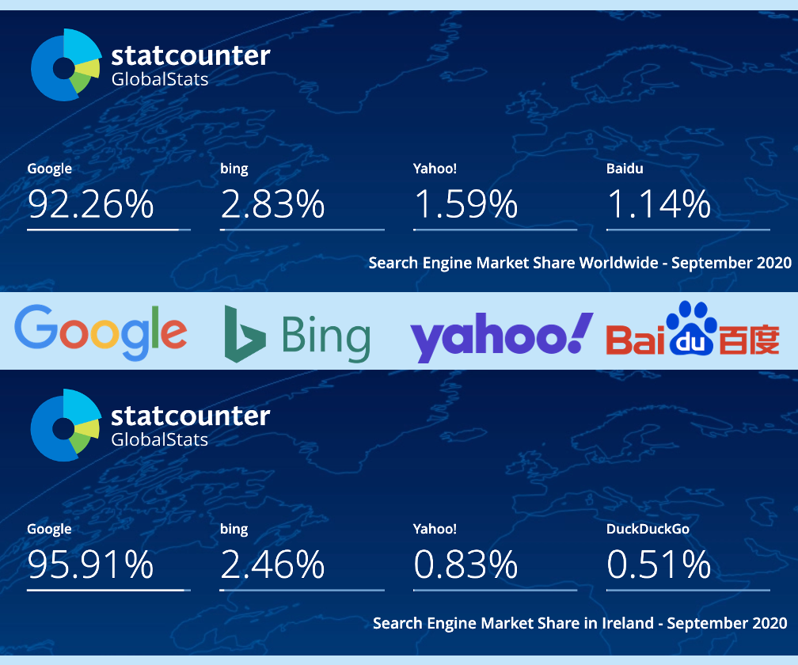



Case C‑131/12 Google Spain v AEPD & González
; image: https://gs.statcounter.com/search-engine-market-share/

Slide 84
Case C‑131/12 Google Spain v AEPD & González
The operator of a search engine is obliged to remove from the list of results displayed, following a search made on the basis of a person’s name, links to web pages, published by third parties and containing information relating to that person that is inadequate, irrelevant or no longer relevant, or excessive in relation to the purposes of the processing.

Slide 85
Article 17 GDPR
Right to erasure (‘right to be forgotten’)
(1) The data subject shall have the right to obtain from the controller the erasure of personal data concerning him or her without undue delay

Slide 86
Article 17 GDPR
Right to erasure (‘right to be forgotten’)
(1) The data subject shall have the right to obtain from the controller the erasure of personal data concerning him or her without undue delay[,] and the controller shall have the obligation to erase personal data without undue delay

Slide 87
Article 17 GDPR
Right to erasure (‘right to be forgotten’)
(1) The data subject shall have the right to obtain from the controller the erasure of personal data concerning him or her without undue delay[,] and the controller shall have the obligation to erase personal data without undue delay[,] where
one of the following grounds
applies:

Slide 88
Article 17 GDPR
Right to erasure (‘right to be forgotten’)
(a) no longer necessary;
(b) withdraws consent;
(c) objects;
(d) unlawful processing.

Slide 89
Article 17 GDPR
Right to erasure (‘right to be forgotten’)
(3) Para (1) shall not apply to the extent that processing is necessary [for]:
(a) freedom of expression;
…
(c) reasons of public interest in the area
of public health;
(d) research;
…

Slide 90
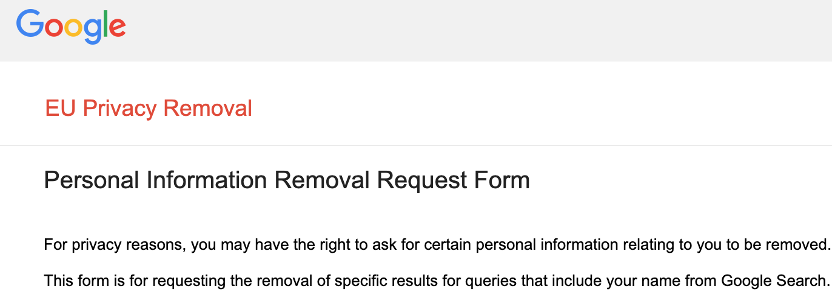
Article 17 GDPR
Right to erasure (‘right to be forgotten’)
; image: https://www.google.com/webmasters/tools/legal-removal-request?complaint_type=rtbf&visit_id=637202230061146146-20083139&rd=1

Slide 91
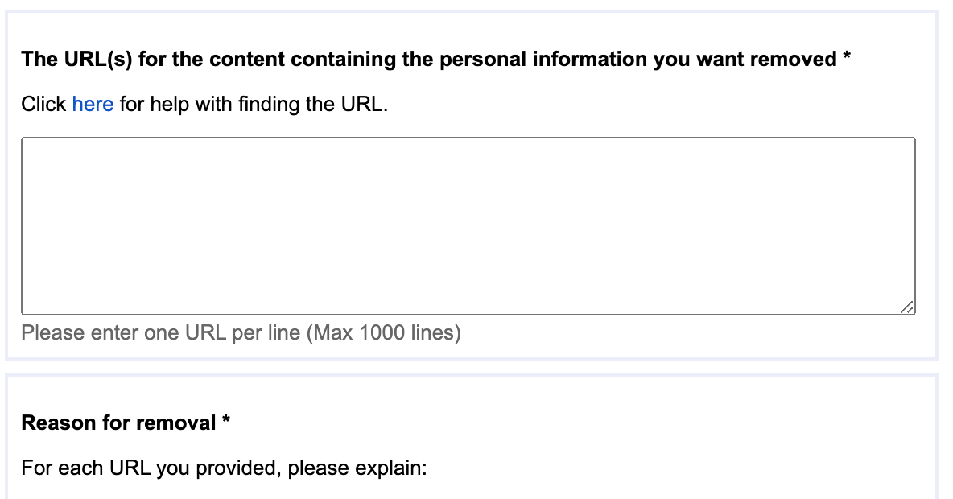
Article 17 GDPR
Right to erasure (‘right to be forgotten’)
; image: https://www.google.com/webmasters/tools/legal-removal-request?complaint_type=rtbf&visit_id=637202230061146146-20083139&rd=1

Slide 92
RtbF Timeline
13 May 14 | End May 14 | 6 Feb 15 | Mid June 15 | 25 May 18 | End Oct 20 | End Oct 22
Google Spain | First RtbF request received | Report of Advisory Council | RtbF requests for 1m URLs (c280,000 requests) | GDPR becomes effective | 1 million RtbF requests (c4M URLs) | 1.33 million RtbF requests (c5.2m URLs)
; source: derived from Google Transparency Reports

Slide 93
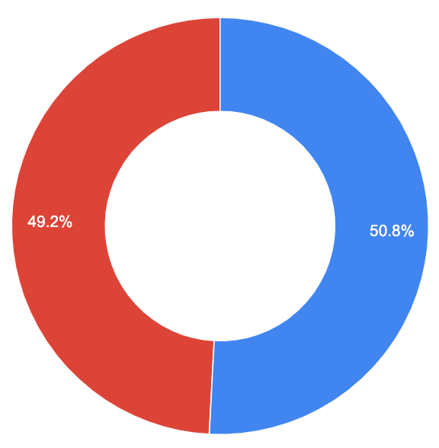
RtbF Timeline
13 May 14 | End May 14 | 6 Feb 15 | Mid June 15 | 25 May 18 | End Oct 20 | End Oct 22
Google Spain | First RtbF request received | Report of Advisory Council | RtbF requests for 1m URLs (c280,000 requests) | GDPR becomes effective | 1 million RtbF requests (c4M URLs) | 1.33 million RtbF requests (c5.2m URLs)
49.2% URLs 50.8% URLs
Delisted Not delisted
; source: derived from Google Transparency Reports

Slide 94
Section 92 Data Protection Act 2018
Right to rectification or erasure …
(1)&(2) [rectification];
; text: http://www.irishstatutebook.ie/eli/2018/act/7/section/91/enacted/en/html#sec91

Slide 95
Section 92 Data Protection Act 2018
Right to rectification or erasure …
(1)&(2) [rectification];
(3) [Erasure on grounds of Art 17 GDPR];
; text: http://www.irishstatutebook.ie/eli/2018/act/7/section/91/enacted/en/html#sec91

Slide 96
Section 92 Data Protection Act 2018
Right to rectification or erasure …
(1)&(2) [rectification];
(3) [Erasure on grounds of Art 17 GDPR];
(4) Erase ASAP, within one month;
; text: http://www.irishstatutebook.ie/eli/2018/act/7/section/91/enacted/en/html#sec91

Slide 97
Section 92 Data Protection Act 2018
Right to rectification or erasure …
(1)&(2) [rectification];
(3) [Erasure on grounds of Art 17 GDPR];
(4) Erase ASAP, within one month;
(5)&(6) reasonable information;
(7)&(8) In complex cases, may add up to
two more months.
; text: http://www.irishstatutebook.ie/eli/2018/act/7/section/91/enacted/en/html#sec91

Slide 98
How to make an erasure request
Adam Ant
Stand and Deliver
; image: https://www.flickr.com/photos/onionskn/7986185415/

Slide 99

Article 17 GDPR
Right to erasure (‘right to be forgotten’)
Ego-surf (vanity search, ego-search, auto-google, self-google etc):
to search for one’s own name
on a popular search engine.
; image: https://pixabay.com/illustrations/surfing-surf-cartoon-wood-water-4617672/

Slide 100
Reminder: Assessment
Please do a GDPR data subject access request or a right to be forgotten/erasure request.
Choose your target service via the link on Blackboard. We would very much like some diversity in terms of service providers, so please don’t all choose the obvious one(s).
This assessment is worth 25% of your final mark.
Submit via Blackboard on or before 30
November 2021 (anytime on Earth).

Slide 101
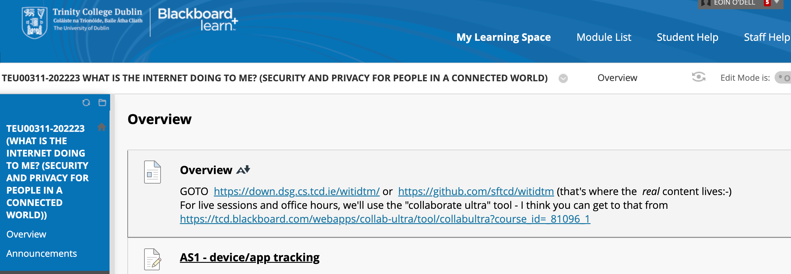
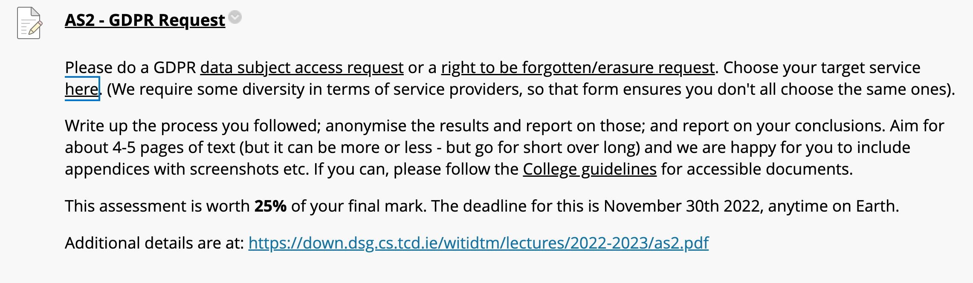



Reminder: Assessment
; image: via Blackboard

Slide 102
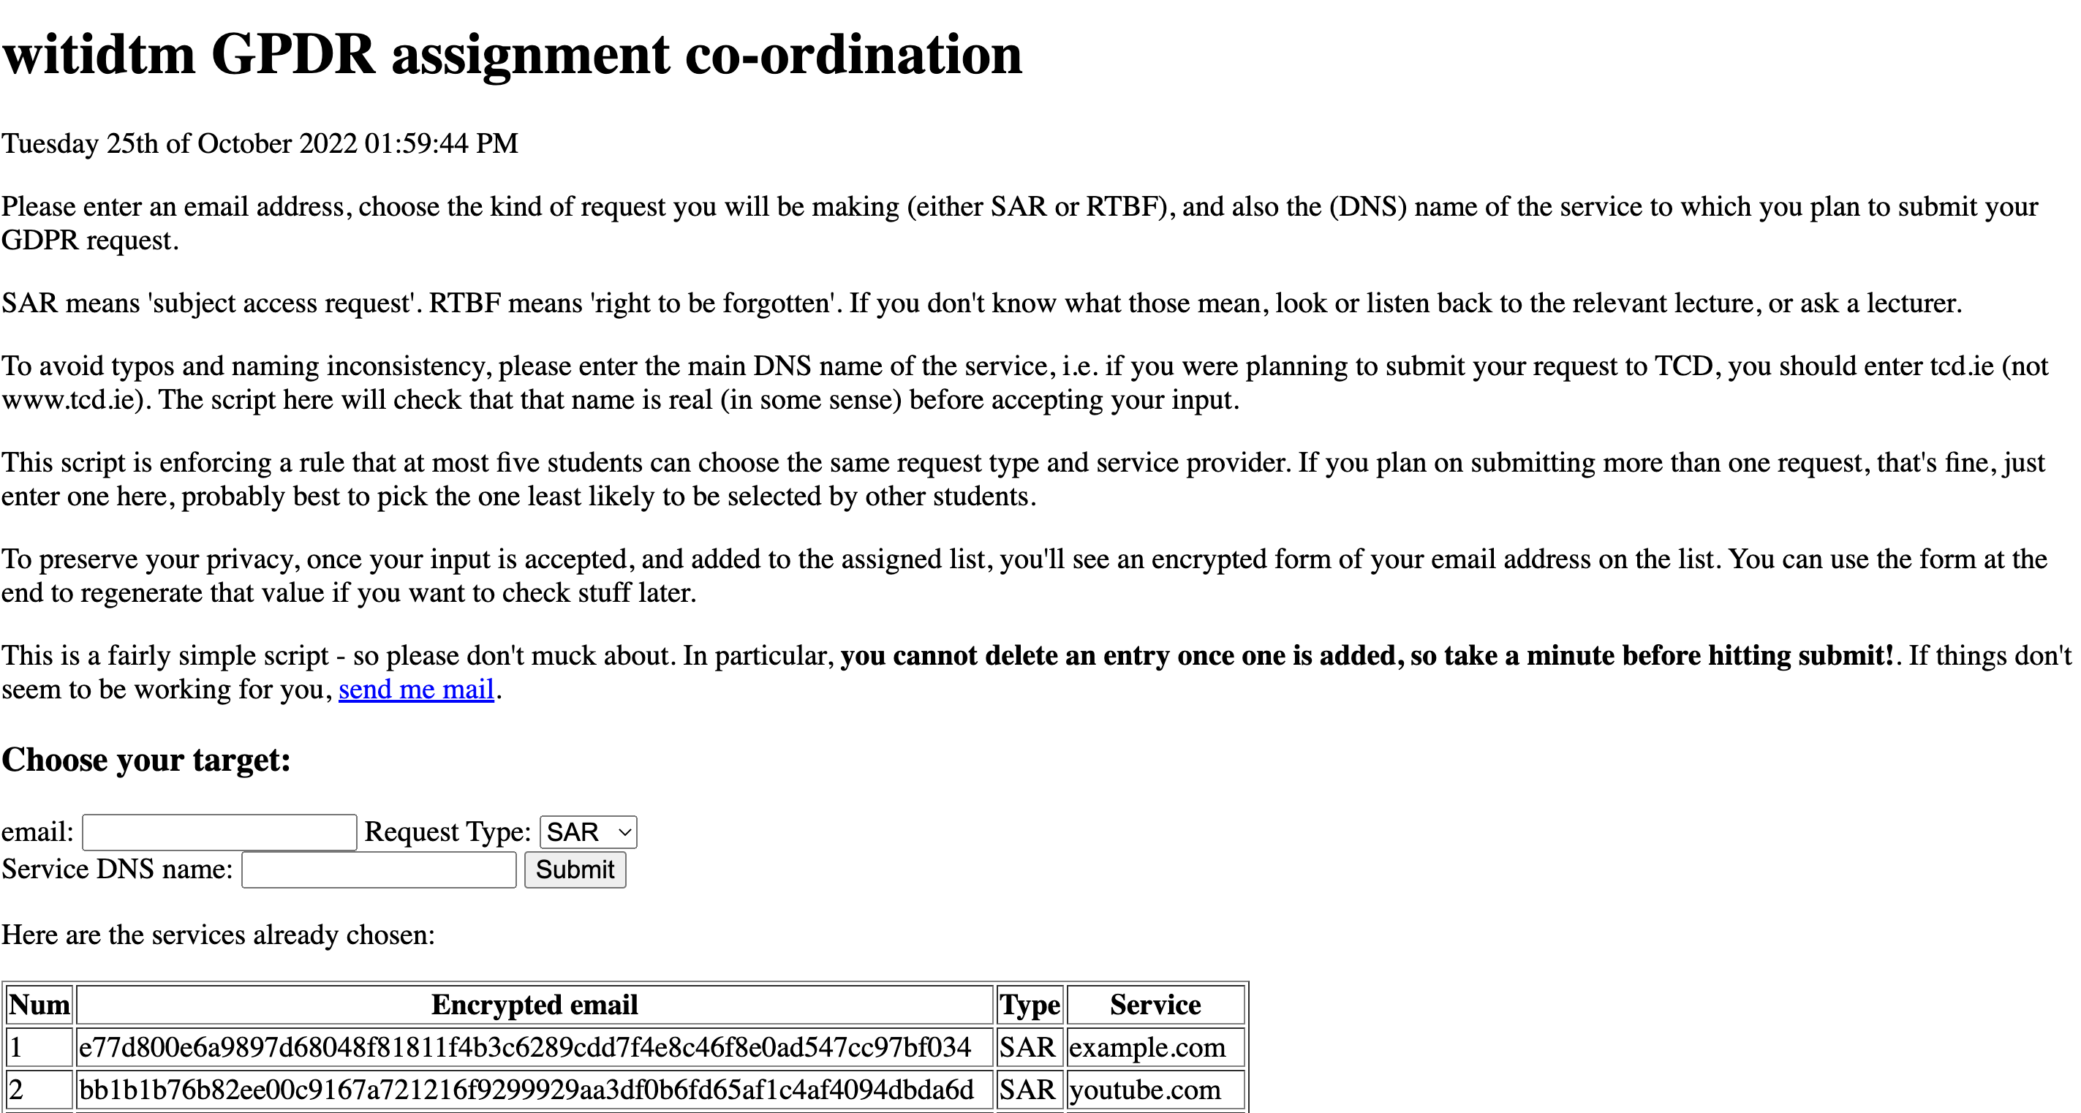
Reminder: Assessment
; image: via Blackboard

Slide 103


Reminder: Assessment
; image: https://www.flickr.com/photos/91261194@N06/49739671687

Slide 104

Thanks
; image: https://commons.wikimedia.org/wiki/File:Thank_you_001.jpg

